Slide 1


DS PROJECT
Abhishek S Kumar 2001ME03
Adil Jamal 2001ME06
Boddu Sadvik 2001EE12
Mudumala Dinesh 2001EE36
Shubham 2001ME72
S Rishiraj 2001EE58
Grp-35

Slide 2
ANDHRA PRADHESH HEALTH CARE INSURANCE
Aarogyasri Scheme
A unique Community Health Insurance Scheme.
Implemented in Andhra Pradesh in 2007
Provides financial protection up to Rs. 2 lakhs per year to families living below poverty line for the treatment of serious ailments requiring hospitalization and surgery
Provides coverage for critical systems like Heart, Lung, Liver, Pancreas, etc.

Slide 3
Key words:-
Preauth amount :- Preauthorization amount is the initial Amount authorized to the insurer along with admitting to paying the claim subject to the final invoice from the hospital.
Preauth date :- The date when preauth amount is authorized
Claim amount :- Amount of money which is to be paid at the maturity of an insurance policy or in event of the death of the insured person
Claim date :- the date when claim amount is issued
Mortality:- death of the insurer

Slide 4
Libraries Used
pandas
numpy
scipy
seaborn
matplotlib
nltk
sklearn
datetime

Slide 5
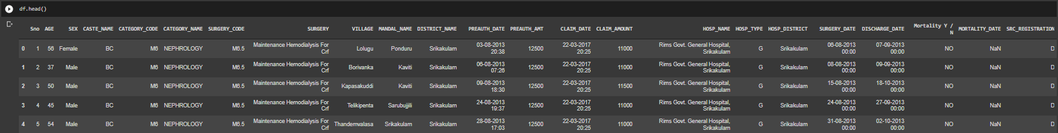
Pre processing and Cleaning

Slide 6
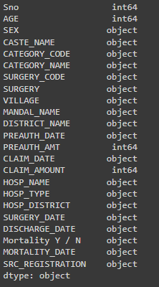
Columns in the Data set

Slide 7
DATA VISUALIZATION
Data visualization is the practice of translating information into a visual context, such as a map or graph, to make data easier for the human brain to understand and pull insights from
The Data of this project can be described in various forms of graphs and plots with the help of the various python libraries discussed earlier

Slide 8
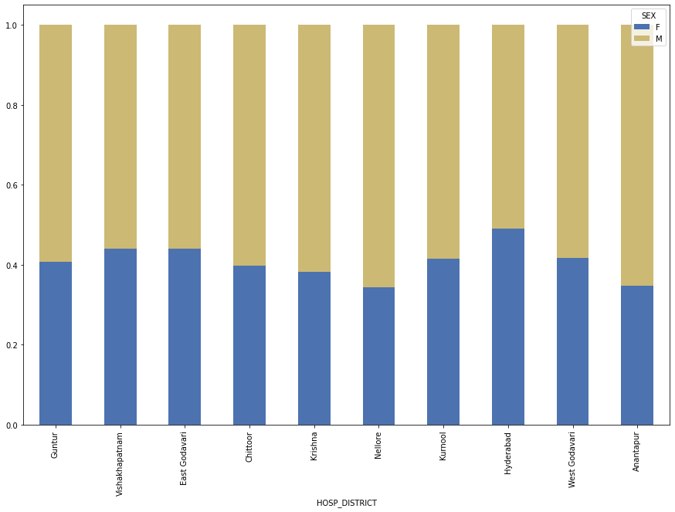
Sex ratio of Insurers in different District

Slide 9
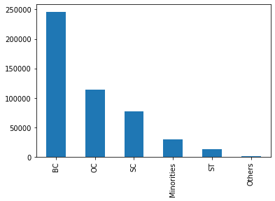
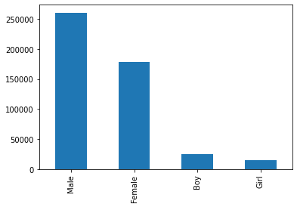
Distribution of people
According to Caste
According to Sex

Slide 10
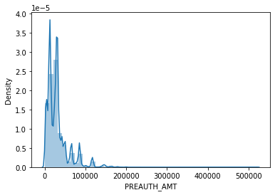
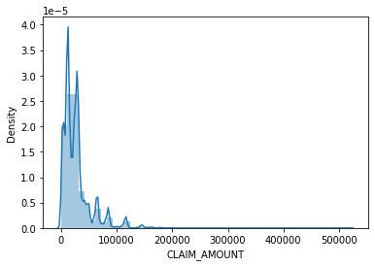
Distribution of Claim and Pre-Auth amount
Pre-authorization amount Distribution
Claim amount Distribution

Slide 11
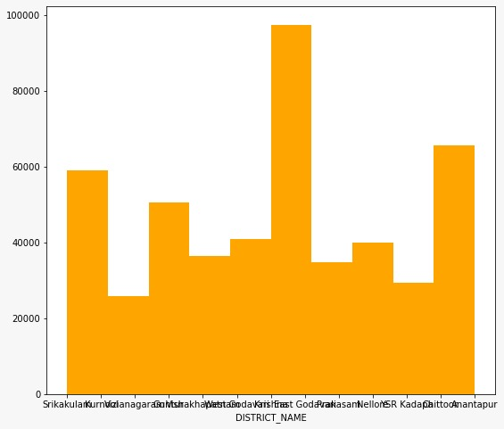
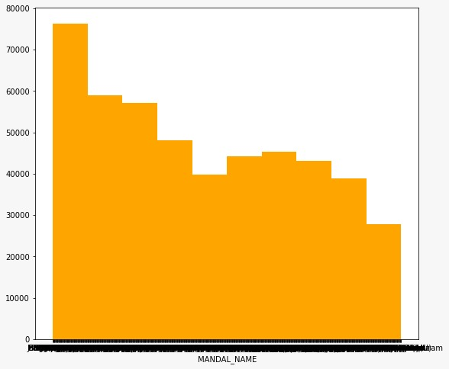
Distribution according to District
Distribution according to Mandal

Slide 12
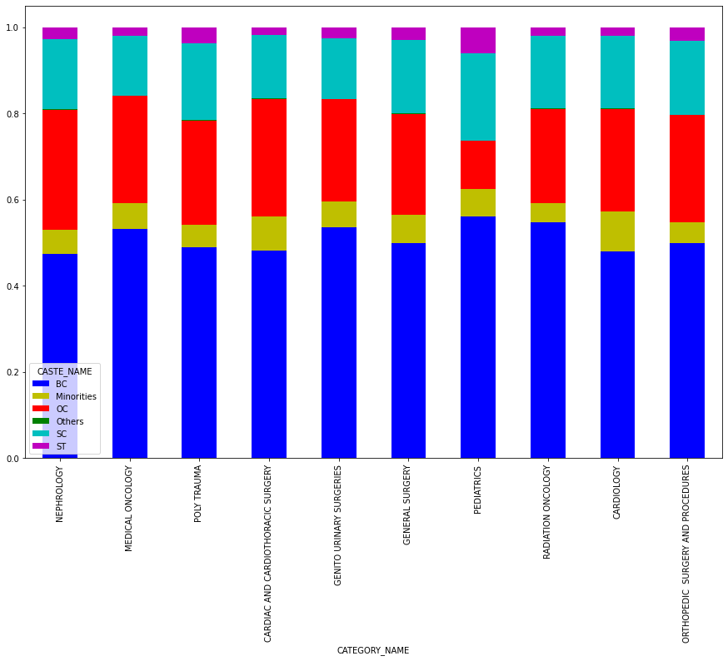
Distribution of people according to Category and caste(as per the ratio)

Slide 13
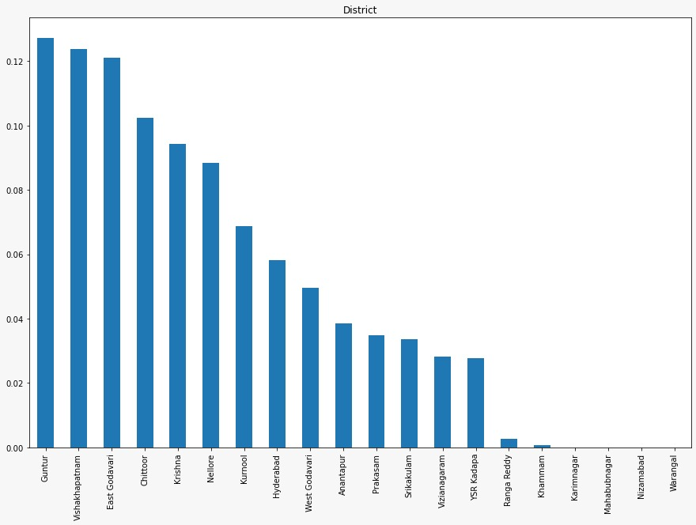
Distrubution of Population with
Respect to Districts

Slide 14
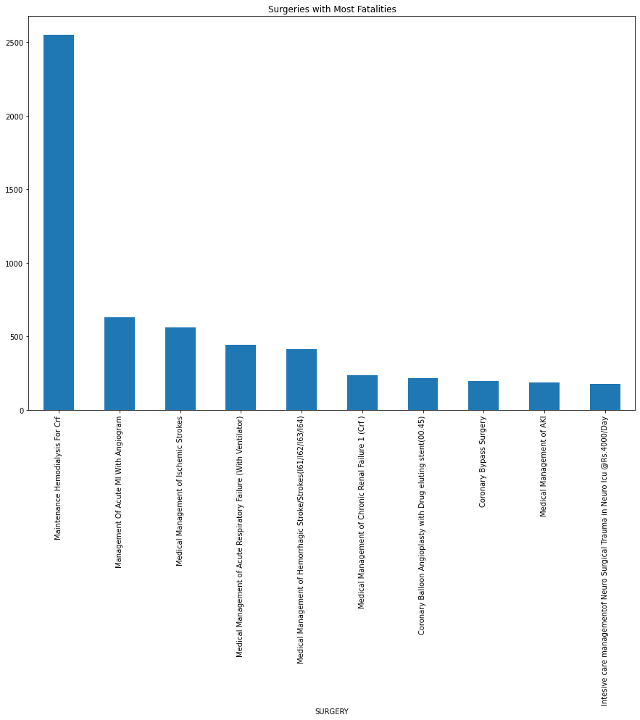
Surgeries with most fatalities

Slide 15
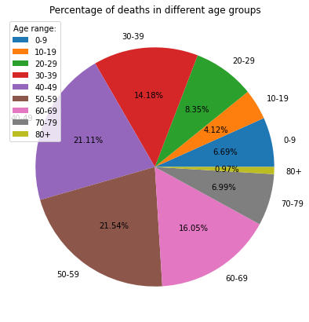
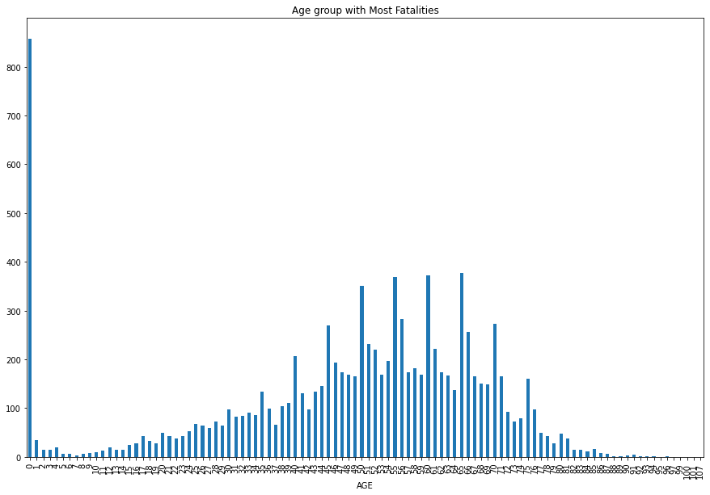

Slide 16
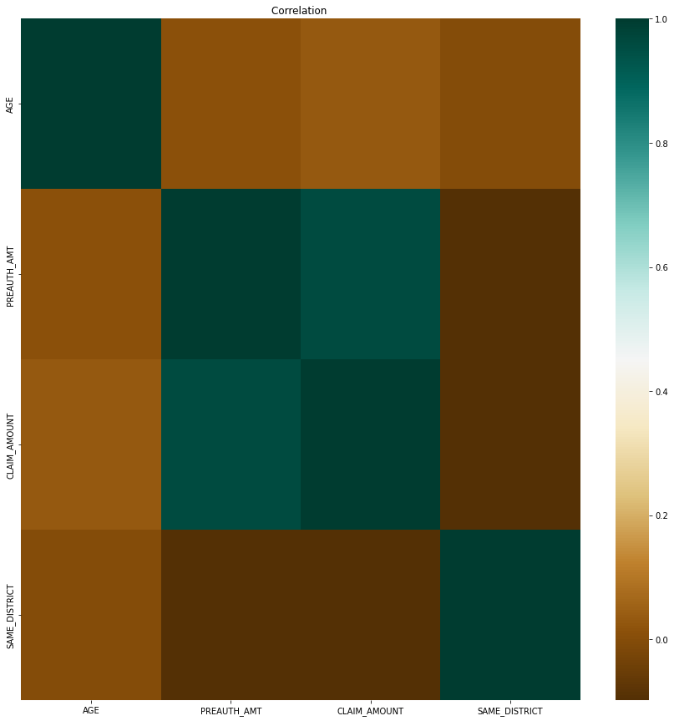
Co-relation between Age, Preauthorization amount, Claim amount and whether the patients district and the district the hospital is located is the same

Slide 17
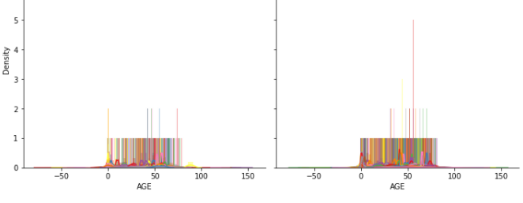
Distribution of Pre-Auth amount for different ages in different hospitals

Slide 18
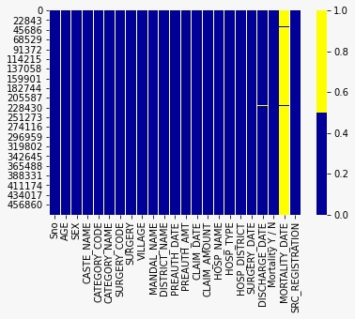
Heat map for missing values

Slide 19
DATA STATISTICS
Statistics is basically a science that involves data collection, data interpretation and finally, data validation.
The Data stats consists the terms mean , median , mode , standard deviation , count , variance and other related terms…

Slide 20
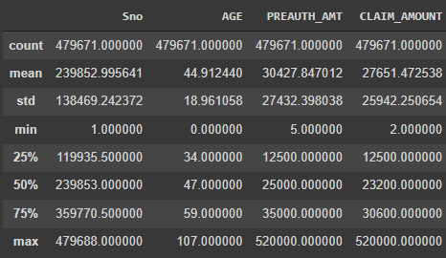
Data statistics for this dataset

Slide 21
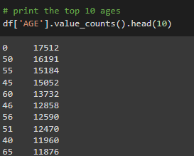
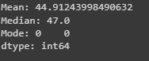
Statstics for Age :-

Slide 22
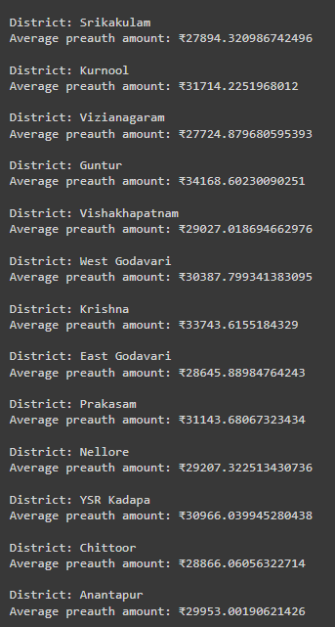
Average Pre-Auth Amount For Each District

Slide 23
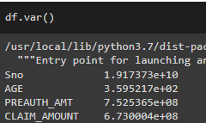
VARIANCE FOR DIFFERENT VALUES:-

Slide 24
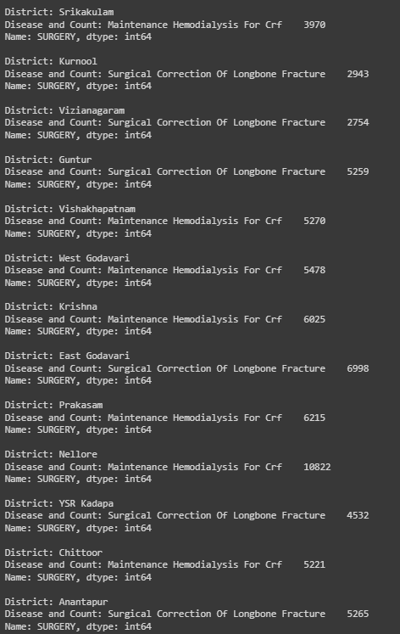
Most common disease in each District
and count of the Disease

Slide 25
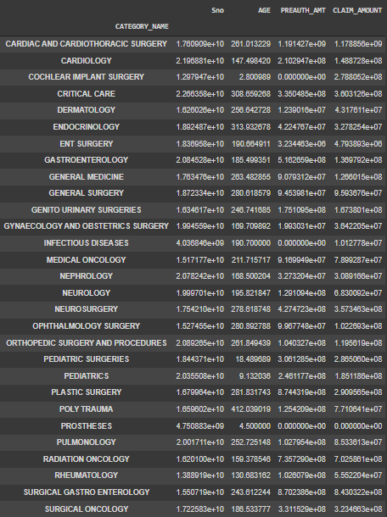
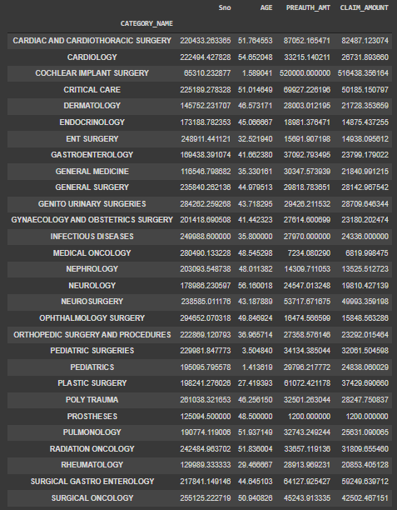
Mean for each category
Variance for each category

Slide 26
Hypothesis testing
Hypothesis testing is a statistical technique that helps scientists and researchers test the validity of their claims about the real-world/real-life events.
Hypothesis testing techniques are often used in statistics and data science to analyze whether the claims about the occurrence of the events is true.

Slide 27
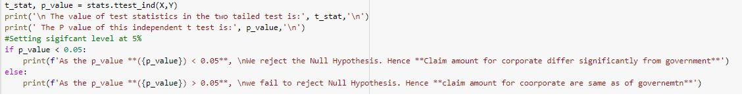
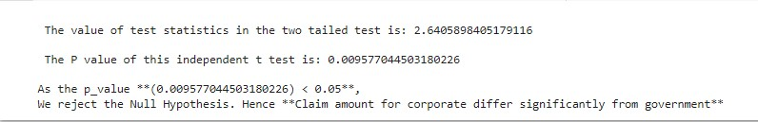
First Hypothesis
Null hypothesis
H₀= The Claim amount for Corporate is same as Government Hospitals
Alternate Hypothesis
H₁ = The Claim amount differs in Govt and private hospital
Result
Notes:
Independent t test for claim amount….since the claim amount vary by significant amounts for different surgeries the sample population of SURGERY_CODE = S15.5.2

Slide 28
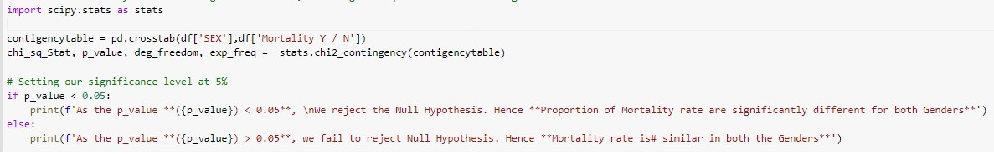
Second Hypothesis
Null hypothesis
H₀= The Mortality rate are similar for both the genders
Alternate Hypothesis
H₁ = The Mortality rate are significantly different for both genders
Result

Slide 29
THANK YOU

